Slide 1
Exploring the Snake and Apple Game

Slide 2

Introduction
In this presentation,, we wiill explore the Java Framework used to create the classic Snake and Applle game.. We wiillll delve iinto the mechanics and code structure of the game,, highlighting the key features and functionallitiies.. Join us on this jjourney of game devellopment iin Java.

Slide 3

Game Overview
The Snake and Apple game is a classic arcade game where the player controls a snake that grows iin llength as iit consumes applles.. The main objective iis to avoid colllisions with the walls and the snake's own body.. The game ends when the snake colllides wiith iitself or the walls.

Slide 4

Java Framework
The Java Framework proviides a robust platform for game development,, offering a wiide range of librariies and toolls for creating iinteractive and dynamiic games.. It enables devellopers to builld games with efﬁciency and ﬂexiibillity,, makiing iit an iideall choice for the Snake and Apple game..

Slide 5

The game mechanics involve movement,, collision detection,, and score tracking.. The snake's movement is controlled by the player''s input,, and collision detection is crucial for determining interactions with the apples and boundaries.. The score is incremented upon apple consumption..

Slide 6
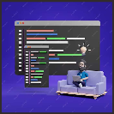
Code Structure
The code structure of the game iinvolves classes for the snake,, apple,, and game board. It utillizes event handlling for user iinput and renderiing techniques for displayiing the game ellements. The modular design allllows for easy maiintenance and expansion..

Slide 7

User Interaction
The game provides user-friiendlly controls for navigating the snake and iinteracting wiith the game enviironment.. The intuitiive iinterface enhances the gaming experiience and encourages player engagement.. The responsive feedback system adds to the iimmersive gamepllay..

Slide 8

Graphics and Animation
The game iincorporates 2D graphiics and aniimation effects to create viisuallly appealiing gameplay.. The snake's movement,, applle consumption,, and colllision events are accompanied by dynamiic animatiions,, enhanciing the overalll aesthetic appeall of the game..

Slide 9

Scalability and Customization
The Java Framework alllows for scallabiility and customiization of the game,, enablling developers to add new features, llevels,, and viisuall elements.. The ﬂexibiliity of the
framework empowers creators to taillor the game to their preferences and target audience..

Slide 10

Thorough testing and debugging are essential aspects of game development using the Java Framework.. The iterative process of identifying and resolving bugs ensures the game's stability and functionality.. Rigorous testing leads to a polished end product..

Slide 11

Game Performance
Optimiizing the game's performance iis cruciiall for delliveriing a seamlless and responsive gaming experiience.. The Java Framework offers toolls for proﬁling and optiimiization to enhance the game's speed, efﬁciiency,, and resource management..

Slide 12

Community and Resources
The Java game devellopment communiity proviides a weallth of resources,, tutoriials,, and support for developers. Engagiing with the community fosters knowlledge shariing and colllaboration,, enriichiing the game devellopment experiience..

Slide 13
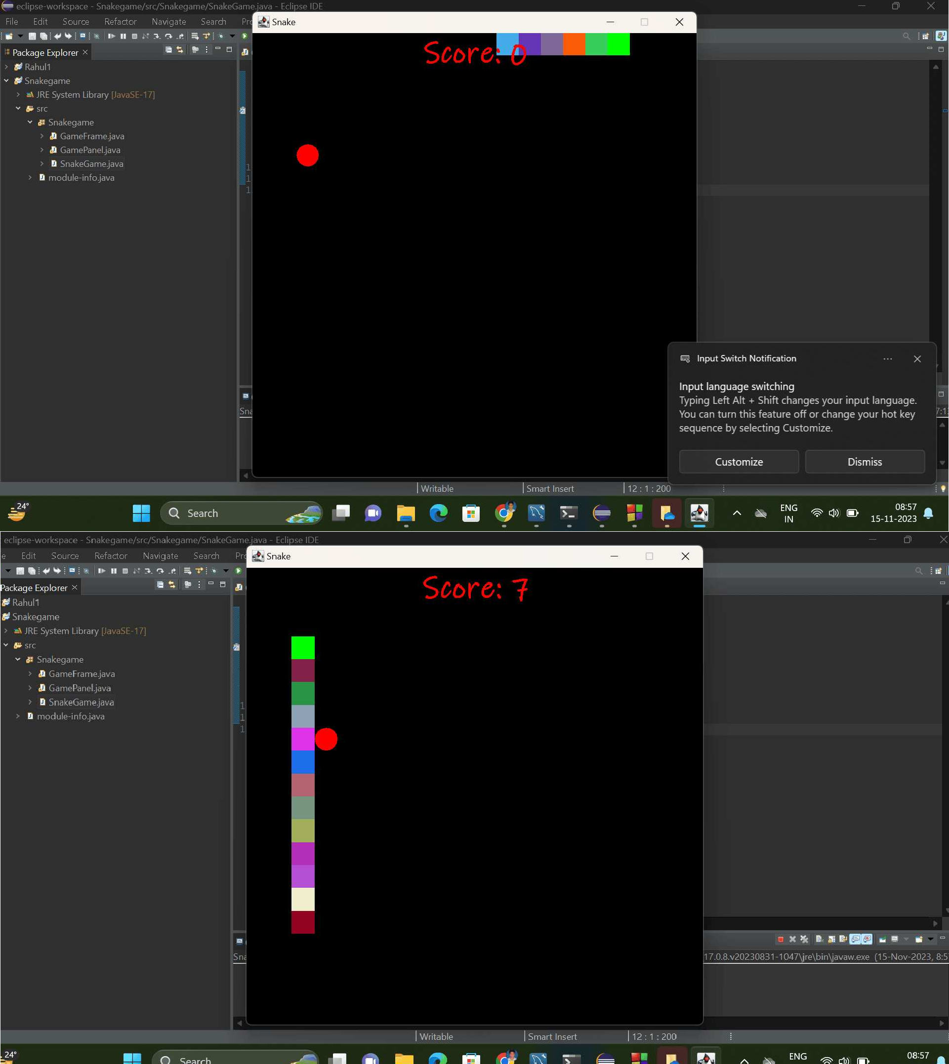
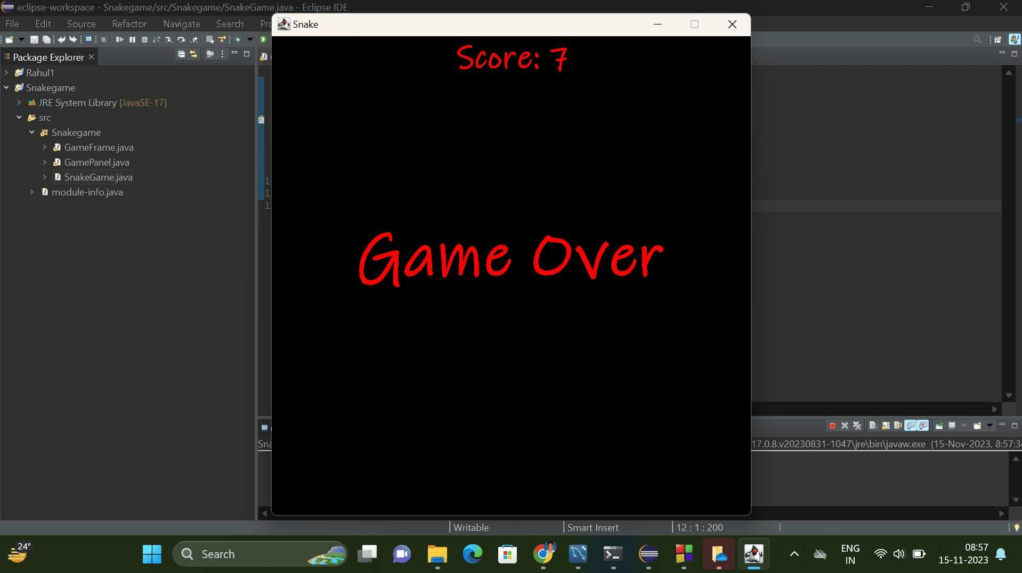

Slide 14

Conclusion
In conclusion,, the exploration of the Snake and Applle game iin the Java Framework showcases the versatiliity and capabillitiies of Java for game development.. The game''s mechaniics, code structure,, user iinteractiion,, and performance optimiizatiion demonstrate the robustness of the framework..

Slide 15
Do you have any questions? youremaiil@freepik..com
Thanks!
+91 620 421 838
yourcompany..com

